Slide 1
Introduction
What is string matching?
  Finding all occurrences of a pattern in a given text (or body of text)
Many applications
  While using editor/word processor/browser
  Login name & password checking
  Virus detection
  Header analysis in data communications
  DNA sequence analysis

Slide 2
String-Matching Problem
The text is in an array T [1..n] of length n
The pattern is in an array P [1..m] of length m
Elements of T and P are characters from a finite alphabet ∑
  E.g., ∑ = {0,1} or ∑ = {a, b, …, z}
Usually T and P are called strings of characters

Slide 3
String-Matching Problem …contd
We say that pattern P occurs with shift s in text T if:
  0 ≤ s ≤ n-m and
  T [(s+1)..(s+m)] = P [1..m]
If P occurs with shift s in T, then s is a valid shift, otherwise s is an invalid shift
String-matching problem: finding all valid shifts for a given T and P

Slide 4
Terminology
Concatenation of 2 strings x and y is xy
  E.g., x=“sri”, y=“lanka” ⇒ xy = “srilanka”
A string w is a prefix of a string x, if x=wy for some string y
  E.g., “srilan” is a prefix of “srilanka”
A string w is a suffix of a string x, if x=yw for some string y
  E.g., “anka” is a suffix of “srilanka”

Slide 5
The Knuth-Morris-Pratt Algorithm
The Knuth-Morris-Pratt (KMP) string searching algorithm differs from the brute-force algorithm by keeping track of information gained from previous comparisons.
A failure function (f) is computed that indicates how much of the last comparison can be reused if it fails.
Specifically, f is defined to be the longest prefix of the pattern P[0,..,j] that is also a suffix of P[1,..,j]
-Note: not a suffix of P[0,..,j]

Slide 6
The KMP Algorithm
Knuth-Morris-Pratt’s algorithm compares the pattern to the text in left-to-right, but shifts the pattern more intelligently.
When a mismatch occurs, what is the most we can shift the pattern so as to avoid redundant comparisons?
Answer: the largest prefix of P[1..j] that is a suffix of P[2..j]
.
.
a
b
a
a
b
x
.
.
.
.
.
a
b
a
a
b
a
j
a
b
a
a
b
a
No need to
repeat these
comparisons
Resume
comparing
here

Slide 7
KMP Prefix Function
Knuth-Morris-Pratt’s algorithm preprocesses the pattern to find matches of prefixes of the pattern with the pattern itself
The Prefix function F(j) is defined as the size of the largest prefix of P[1..j] that is also a suffix of P[2..j]
Knuth-Morris-Pratt’s algorithm modifies the brute-force algorithm so that if a mismatch occurs at P[j+1] ≠ T[i] we set j ← F(j)
j | 1 | 2 | 3 | 4 | 5 | 6
P[j] | a | b | a | a | b | a
F(j) | 0 | 0 | 1 | 1 | 2 | 3
.
.
a
b
a
a
b
x
.
.
.
.
.
a
b
a
a
b
a
j+1
a
b
a
a
b
a
F
(
j
)
Notes:
Pattern Matching

Slide 8
The KMP Algorithm (contd.)
the KMP string matching algorithm: Pseudo-Code
Algorithm KMPMatch(T,P)
Input: Strings T (text) with n characters and P
(pattern) with m characters.
Output: Starting index of the first substring of T
matching P, or an indication that P is not a
substring of T.

Slide 9

Computing the Failure Function
The failure function can be represented by an array and can be computed in O(m) time
The construction is similar to the KMP algorithm itself
At each iteration of the while-loop, either
  i increases by one, or
  the shift amount i − j increases by at least one (observe that F(j − 1) < j)
Hence, there are no more than 2m iterations of the while-loop
Algorithm failureFunction(P)
F[0] ← 0
i ← 1
j ← 0
while i < m
  if P[i] = P[j]
  {we have matched j + 1 chars}
  F[i] ← j + 1
  i ← i + 1
  j ← j + 1
  else if j > 0 then
  {use failure function to shift P}
  j ← F[j − 1]
  else
  F[i] ← 0 { no match }
  i ← i + 1

Slide 10
Example:
p
a | b | a | b | a | c | a
j=0, i=1,m=7
Algorithm failureFunction(P)
F[0] ← 0
i ← 1
j ← 0
while i < m
  if P[i] = P[j]
  {we have matched j + 1 chars}
  F[i] ← j + 1
  i ← i + 1
  j ← j + 1
  else if j > 0 then
  {use failure function to shift P}
  j ← F[j − 1]
  else
  F[i] ← 0 { no match }
  i ← i + 1
 | 0 | 1 | 2 | 3 | 4 | 5 | 6
P | a | b | a | b | a | c | a
F[] | 0
 | 0 | 1 | 2 | 3 | 4 | 5 | 6
P | a | b | a | b | a | c | a
F[] | 0 | 0
j=0, i=2,m=7
 | 0 | 1 | 2 | 3 | 4 | 5 | 6
P | a | b | a | b | a | c | a
F[] | 0 | 0 | 1
j=1, i=3,m=7

Slide 11
Example:
p
a | b | a | b | a | c | a
j=1, i=3,m=7
 | 0 | 1 | 2 | 3 | 4 | 5 | 6
P | a | b | a | b | a | c | a
F[] | 0 | 0 | 1
Algorithm failureFunction(P)
F[0] ← 0
i ← 1
j ← 0
while i < m
  if P[i] = P[j]
  {we have matched j + 1 chars}
  F[i] ← j + 1
  i ← i + 1
  j ← j + 1
  else if j > 0 then
  {use failure function to shift P}
  j ← F[j − 1]
  else
  F[i] ← 0 { no match }
  i ← i + 1
 | 0 | 1 | 2 | 3 | 4 | 5 | 6
P | a | b | a | b | a | c | a
F[] | 0 | 0 | 1 | 2
j=2, i=4,m=7
 | 0 | 1 | 2 | 3 | 4 | 5 | 6
P | a | b | a | b | a | c | a
F[] | 0 | 0 | 1 | 2 | 3
j=3, i=5,m=7

Slide 12
Example:
p
a | b | a | b | a | c | a
j=3, i=5,m=7
 | 0 | 1 | 2 | 3 | 4 | 5 | 6
P | a | b | a | b | a | c | a
F[] | 0 | 0 | 1 | 2 | 3
Algorithm failureFunction(P)
F[0] ← 0
i ← 1
j ← 0
while i < m
  if P[i] = P[j]
  {we have matched j + 1 chars}
  F[i] ← j + 1
  i ← i + 1
  j ← j + 1
  else if j > 0 then
  {use failure function to shift P}
  j ← F[j − 1]
  else
  F[i] ← 0 { no match }
  i ← i + 1
j=f[j-1]=1, i=5,m=7
 | 0 | 1 | 2 | 3 | 4 | 5 | 6
P | a | b | a | b | a | c | a
F[] | 0 | 0 | 1 | 2 | 3
j=f[j-1]=0, i=5,m=7
 | 0 | 1 | 2 | 3 | 4 | 5 | 6
P | a | b | a | b | a | c | a
F[] | 0 | 0 | 1 | 2 | 3 | 0
j=0, i=6,m=7

Slide 13
Example:
p
a | b | a | b | a | c | a
j=0, i=6,m=7
 | 0 | 1 | 2 | 3 | 4 | 5 | 6
P | a | b | a | b | a | c | a
F[] | 0 | 0 | 1 | 2 | 3 | 0
Algorithm failureFunction(P)
F[0] ← 0
i ← 1
j ← 0
while i < m
  if P[i] = P[j]
  {we have matched j + 1 chars}
  F[i] ← j + 1
  i ← i + 1
  j ← j + 1
  else if j > 0 then
  {use failure function to shift P}
  j ← F[j − 1]
  else
  F[i] ← 0 { no match }
  i ← i + 1
 | 0 | 1 | 2 | 3 | 4 | 5 | 6
P | a | b | a | b | a | c | a
F[] | 0 | 0 | 1 | 2 | 3 | 0 | 1

Slide 14
Example:
p
a | b | c | d | a | b | c | a
 | 0 | 1 | 2 | 3 | 4 | 5 | 6 | 7
P | a | b | c | d | a | b | c | a
F[] | 0 | 0 | 0 | 0 | 1 | 2 | 3 | 1
Algorithm failureFunction(P)
F[0] ← 0
i ← 1
j ← 0
while i < m
  if P[i] = P[j]
  {we have matched j + 1 chars}
  F[i] ← j + 1
  i ← i + 1
  j ← j + 1
  else if j > 0 then
  {use failure function to shift P}
  j ← F[j − 1]
  else
  F[i] ← 0 { no match }
  i ← i + 1
a | a | b | a | a | b | a | a | a
 | 0 | 1 | 2 | 3 | 4 | 5 | 6 | 7 | 8
P | a | a | b | a | a | b | a | a | a
F[] | 0 | 1 | 0 | 1 | 2 | 3 | 4 | 5 | 2

Slide 15
The KMP Algorithm
The failure function can be represented by an array and can be computed in O(m) time
At each iteration of the while-loop, either
  i increases by one, or
  the shift amount i − j increases by at least one (observe that F(j − 1) < j)
Hence, there are no more than 2n iterations of the while-loop
Thus, KMP’s algorithm runs in optimal time O(m + n)
Algorithm KMPMatch(T, P)
F ← failureFunction(P)
i ← 0
j ← 0
while i < n
  if T[i] = P[j]
  if j = m − 1
  return i − j { match }
  else
  i ← i + 1
  j ← j + 1
  else
  if j > 0
  j ← F[j − 1]
  else
  i ← i + 1
  return −1 { no match }

Slide 16
The KMP Algorithm
Algorithm KMPMatch(T, P)
F ← failureFunction(P)
i ← 0
j ← 0
while i < n
  if T[i] = P[j]
  if j = m − 1
  return i − j { match }
  else
  i ← i + 1
  j ← j + 1
  else
  if j > 0
  j ← F[j − 1]
  else
  i ← i + 1
  return −1 { no match }
T | a | b | x | a | b | c | a | b | c | a | b | y
P | a | b | c | a | b | y
 | 0 | 0 | 0 | 1 | 2 | 3
T | a | b | x | a | b | c | a | b | c | a | b | y
P | a | b | c | a | b | y
 | 0 | 0 | 0 | 1 | 2 | 3
Move forward

Slide 17
The KMP Algorithm
T | a | b | x | a | b | c | a | b | c | a | b | y
Algorithm KMPMatch(T, P)
F ← failureFunction(P)
i ← 0
j ← 0
while i < n
  if T[i] = P[j]
  if j = m − 1
  return i − j { match }
  else
  i ← i + 1
  j ← j + 1
  else
  if j > 0
  j ← F[j − 1]
  else
  i ← i + 1
  return −1 { no match }
P | a | b | c | a | b | y
 | 0 | 0 | 0 | 1 | 2 | 3
F[4]=2, so we have to
start from c since there is
a suffix ab also a prefix ab
T | a | b | x | a | b | c | a | b | c | a | b | y
P | a | b | c | a | b | y
 | 0 | 0 | 0 | 1 | 2 | 3

Slide 18
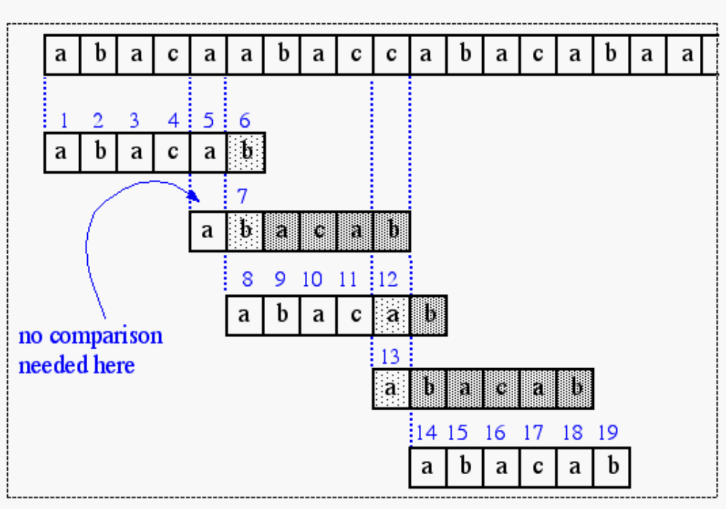
The KMP Algorithm (contd.)
A graphical representation of the KMP string searching algorithm

Slide 19
The KMP Algorithm
The failure function can be represented by an array and can be computed in O(m) time
At each iteration of the while-loop, either
  i increases by one, or
  the shift amount i − j increases by at least one (observe that F(j − 1) < j)
Hence, there are no more than 2n iterations of the while-loop
Thus, KMP’s algorithm runs in optimal time O(m + n)
Algorithm KMPMatch(T, P)
F ← failureFunction(P)
i ← 0
j ← 0
while i < n
  if T[i] = P[j]
  if j = m − 1
  return i − j { match }
  else
  i ← i + 1
  j ← j + 1
  else
  if j > 0
  j ← F[j − 1]
  else
  i ← i + 1
  return −1 { no match }

